Slide 1

Sales Performance Analysis

Slide 2

Title
TASK RECAPE
PROCESS
SALES PERFORMANCE ANALYSIS
INSIGHTS AND RECOMMENDATIONS
IMPLEMENTATION PLANS
Q & A

Slide 3
Task Recape
A retail company aims to optimize its sales performance by leveraging data driven insights to identify trends, patterns and opportunities for improvement.
Analysis work focusing on main insights such as :
Enhancing sales strategies
Improve Inventory management
Revenue Growth

Slide 4
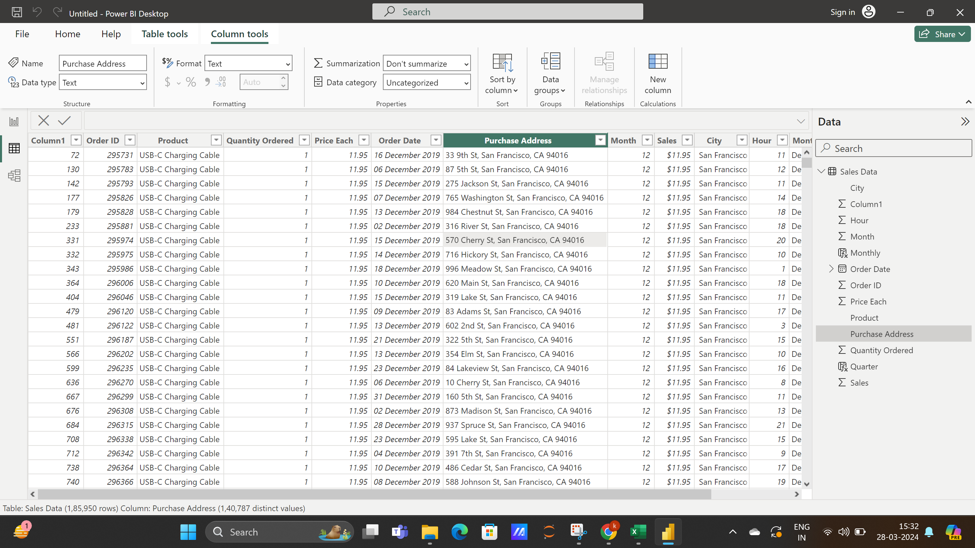

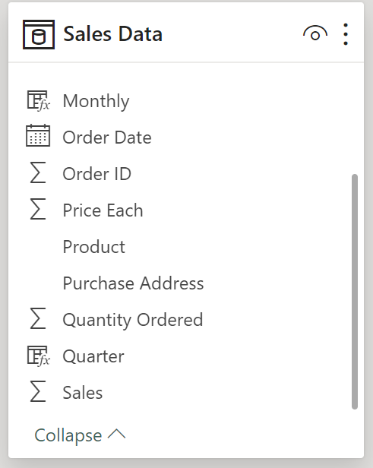
Process
Data Modeling
Data visualization
Insights & Recommendation
Data Understanding
Transform Data into Power Query
Transformation of Data to Power BI

Slide 5
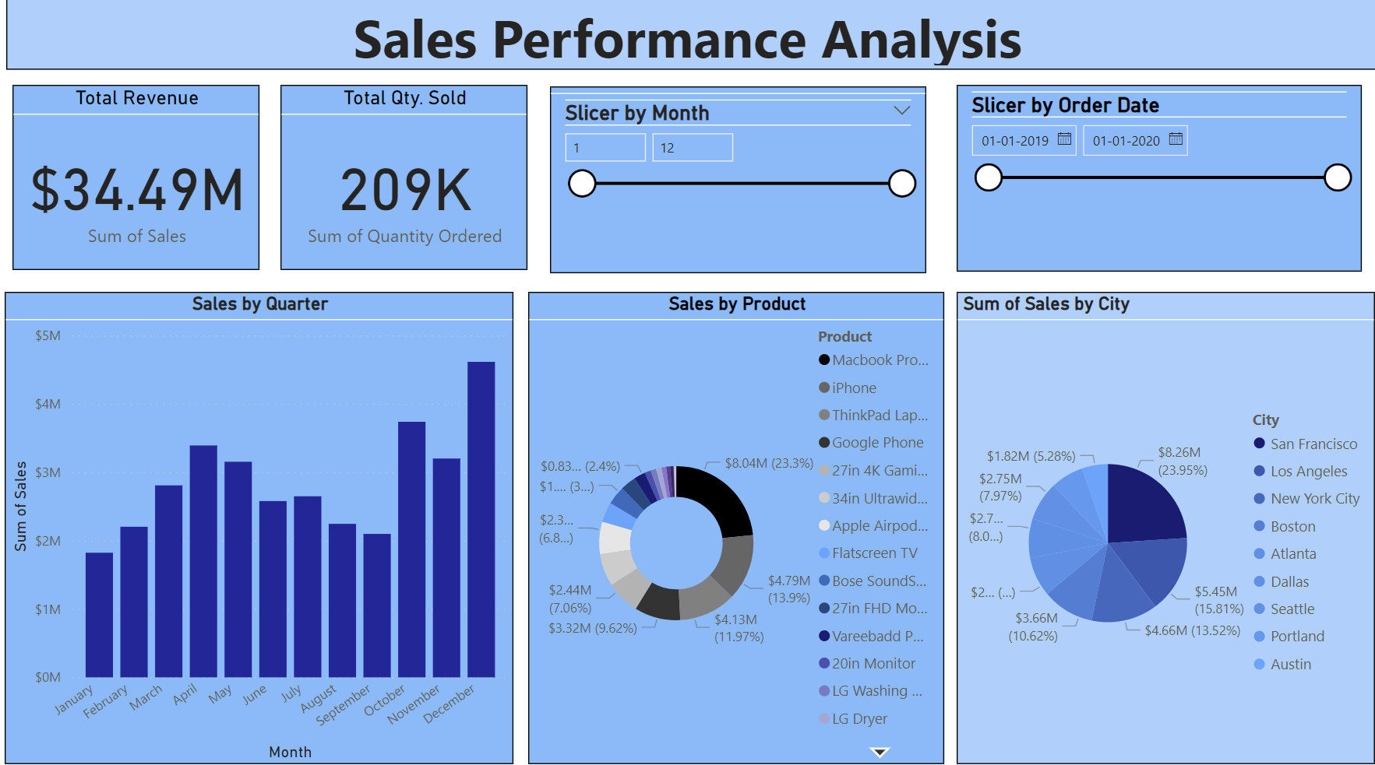

Slide 6
Insights From overall Sales Performance Analysis
Based on the Analysis recommended to Enhance Sales Strategies by targeting specific customer segments (i.e Highest sales in San Francisco) and the product on demanding is Macbook Pro Laptop with the Revenue Generation around $8.26M
Suggestion to launch promotional campaigns to enhance sales in other cities.

Slide 7
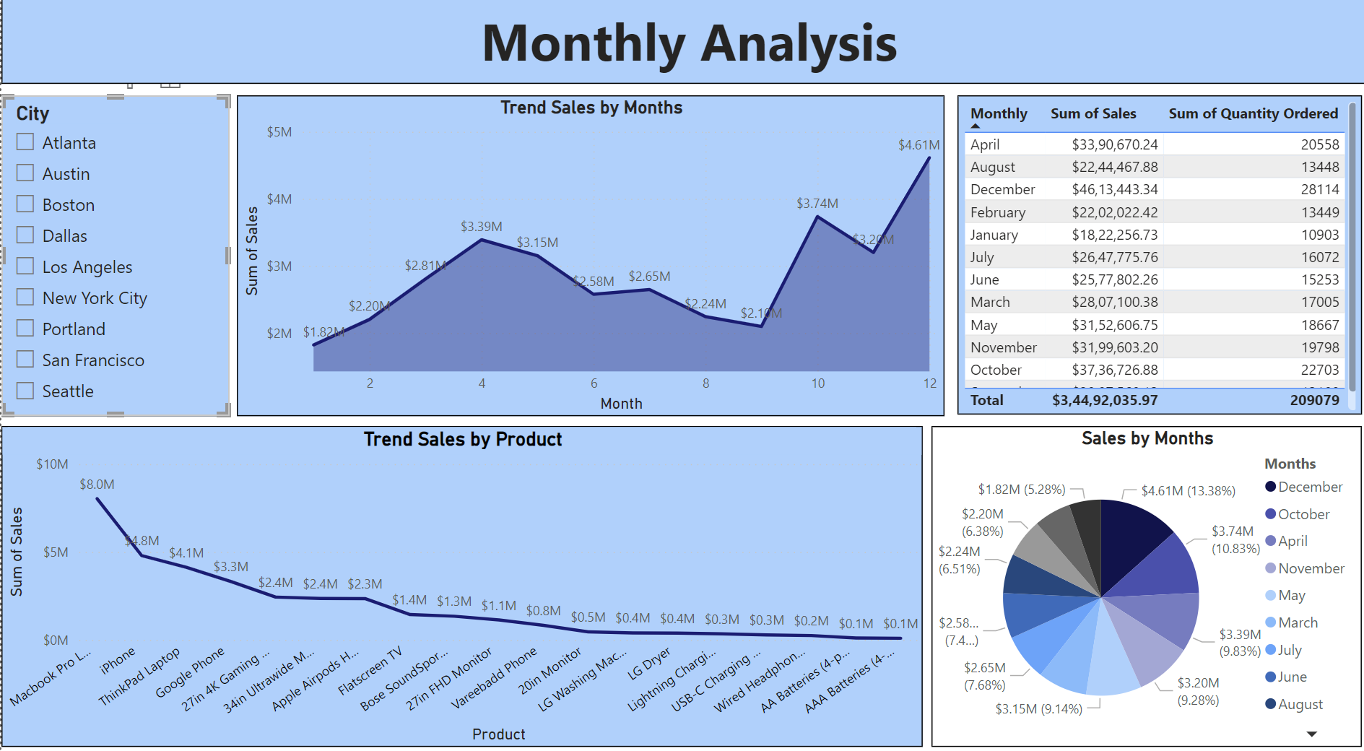

Slide 8
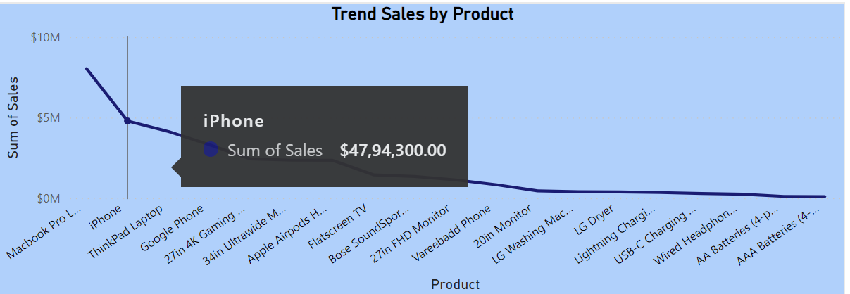
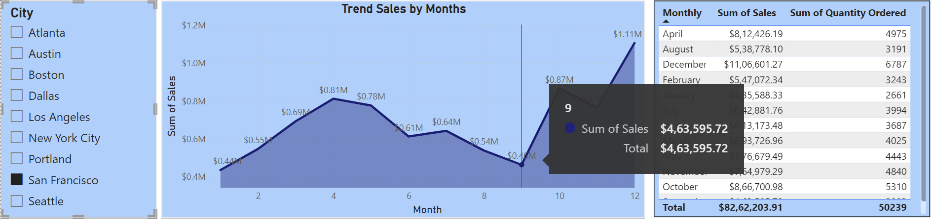
Highest Sales in San Francisco:
Highest product sold- Macbook Pro Laptop
Second Highest iPhone
Monthly Trend downwards from July to September. (Kinked rise in sales From September)

Slide 9
Insights From Monthly Analysis
Recommending to improve inventory management practices by optimizing inventory levels for different products, or implementing better demand forecasting techniques.
A Key Performance Indicator (KPI) is a quantifiable metric that helps organizations evaluate their progress towards achieving important business objectives.
For Revenue Growth:
Tracking Market Trends
Customer Segmentation
Product and Service Analysis
KPI (Key Performance Indicator) (As mentioned above)

Slide 10
Summary
Overall Sales Performance and Revenue Analysis using Power BI empowers stakeholders with actionable insights and recommendations, enabling them to enhance Sales. Through Visualizations; stakeholder can navigate trends, improve inventory management and drive revenue growth.

